Slide 1
PBIS Advanced Tiers
CA PBIS Conference
October 28-29, 2019
Building a Continuum of Behavioral Interventions
for
Advanced
Tiers
Cristy Clouse
Barbara Kelley
Notes:
To change the image on this slide, select the picture and delete it. Then click the Pictures icon in the placeholder to insert your own image.

Slide 2
Today’s Targets
Identify a Continuum of Interventions for Advanced Tiers
De-bunk T3 Myths
Explore the T3 TFI Support Planning Worksheet with:
“Keep it Simple” (efficient BSP)
“Prevent-Teach- Reinforce”(team-based comprehensive BIP)

Slide 3
General Education & Special Education
Tier 1/Universal for Social/Emotional/Behavioral School-Wide Assessment / School-Wide Prevention Systems
Check-In-Check-Out (provides explicit instruction, feedback, structure, reinforcing of tier 1 core)
Use Function- Based Thinking to Make Next Choice
Modified CICO
Social Academic Instructional Groups
Other
&/or
&/or
Efficient/Simple
Function-Based Problem Solving
Individualized Team Development: Complex Function-Based Problem Solving Person-Centered Planning
Notes:
*
At least 2 Tier 2 Interventions before moving to FBA/BIP
It is always our goal to move kids back down to Tier 1 with their level of supports

Slide 4
Continuum of T3 Supports
Level 1
EFFICIENT
Functional Assessment Checklist for Teachers and Staff FACTS
Level 2
COMPREHENSIVE
Level 3
WRAP AROUND
Behavior Intervention Plans (BIP)
Expert Model
Team-based Model
Example:
RENEW
Person-centered Planning
Routine-based Support Plans
Simple PTR Plan

Slide 5
Myth #1
Tier 3 is equal to special education eligibility!

Slide 6
Consideration
Tier 3 includes ALL students who need additional support that is intensive.
It may be short term or unrelated to a diagnosis or eligibility determination.

Slide 7
General Education & Special Education
Tier 1/Universal for Social/Emotional/Behavioral School-Wide Assessment / School-Wide Prevention Systems
Check-In-Check-Out (provides explicit instruction, feedback, structure, reinforcing of tier 1 core)
Use Function- Based Thinking to Make Next Choice
Modified CICO
Social Academic Instructional Groups
Other
&/or
&/or
Efficient/Simple
Function-Based Problem Solving
Individualized Team Development: Complex Function-Based Problem Solving Person-Centered Planning
Notes:
*
At least 2 Tier 2 Interventions before moving to FBA/BIP
It is always our goal to move kids back down to Tier 1 with their level of supports

Slide 8
Myth #2
Tier 3 can only be provided by specialists and is often providing more of the same core intervention but in greater doses.

Slide 9
Consideration
School-based teams are more likely to develop and implement plans that are contextually relevant .
School-based teams that include content specialists are more likely to develop technically adequate plans that are also contextually relevant!

Slide 10
Myth #3
The behavior specialist is the only expert in Tier 3 assessment, intervention, and implementation.

Slide 11
PTR Master
Facilitator
Education Experts | Student Experts | Behavior Experts
Implement Tier 3 strategies | Inform & support Tier 3 | Collaborate to develop Tier 3
Enhance communication with home to support Tier 2 | Enhance communication with school to support Tier 2 | Support education and kid experts in Tier 2
Differentiate Tier 1 PCBS (Positive Classroom Behavior Supports) | Support Tier 1 PCBS (Positive Classroom Behavior Supports) | Support Tier 1 PCBS (Positive Classroom Behavior Supports)
Enhance communication with home to support Tier 2
Everyone is an expert!

Slide 12
Myth #4
Most Tier 3 interventions are too complex and difficult to implement .

Slide 13
Consideration

Slide 14
Tier 3 Features

Slide 15
Antecedents – What happened before problem behavior that makes it more or less likely and allow you to “PREVENT” problem behavior from occurring.
Behavior – Clearly define the problem behavior AND TEACH appropriate behavior to replace problem behavior – same reason (function).
Consequences – REINFORCE appropriate behavior you want to see and decrease reinforcement for problem behavior.
Lifestyle Context – Understanding how what you learn fits into the context of the student’s life, classroom, school, etc. Using person-centered planning techniques to understand the student’s life goals, strengths, needs, support network, etc.
Notes:
Don

Slide 16
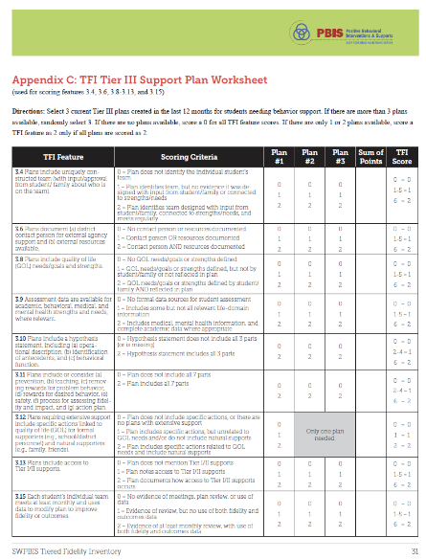
Directions: Select 3 current Tier III plans created in the last 12 months for students needing behavior support. If there are more than 3 plans available, randomly select 3. If there are no plans available, score a 0 for all TFI feature scores. If there are only 1 or 2 plans available, score a TFI feature as 2 only if all plans are scored as 2.

Slide 17
TFI Tier 3 Items
Tiered Fidelity Inventory
TFI Tier III
Support Planning Worksheet
Subscale: Support Plans
Item 3.8: Quality of Life Indicators
Item 3.9: Academic, Social, and Physical Indicators
Item 3.10: Hypothesis Statement
Item 3.11: Comprehensive Support
Item 3.12: Formal & Natural Supports
Item 3.13: Access to Tier 1 & II Supports
Subscale: Evaluation
Item 3.14: Data System
Item 3.15: Data-based Decision Making
Item 3.16: Level of Use
Item 3.17: Annual Evaluation
Subscale: Teams
Item 3.1: Team Composition
Item 3.2: Team Operating Procedures
Item 3.3: Screening
Item 3.4: Student Support Team
Subscale: Resources
Item 3.5: Staffing
Item 3.6: Student/Family/Community Involvement
Item 3.7: Professional Development
Notes:
3.12 requires an extensive plan with person-centered planning ; no exampleof that today

Slide 18
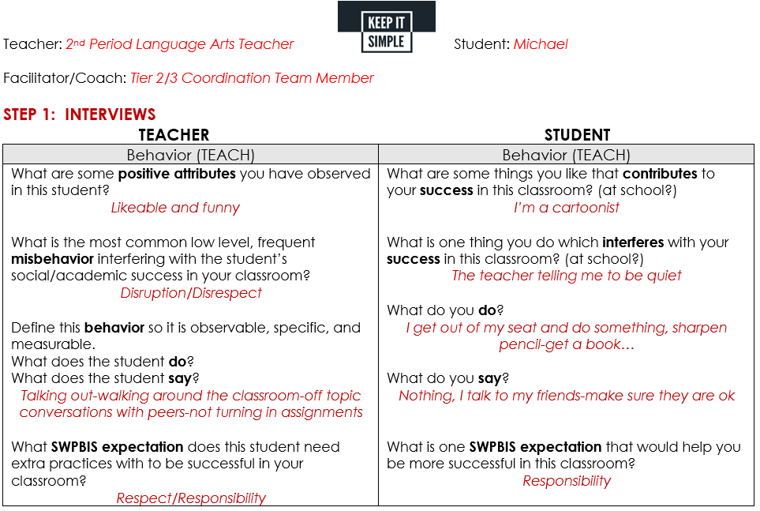
TFI T3 Features:
TFI 3.4 Student Support Team: For each individual student support plan, a uniquely constructed team exists (with input/approval from student/family about who is on the team) to design, implement, monitor, and adapt the student-specific support plan.
TFI 3.8 Quality of Life Indicators: Assessment includes student strengths and identification of student/family preferences for individualized support options to meet their stated needs across life domains (e.g., academics, health, career, social).

Slide 19
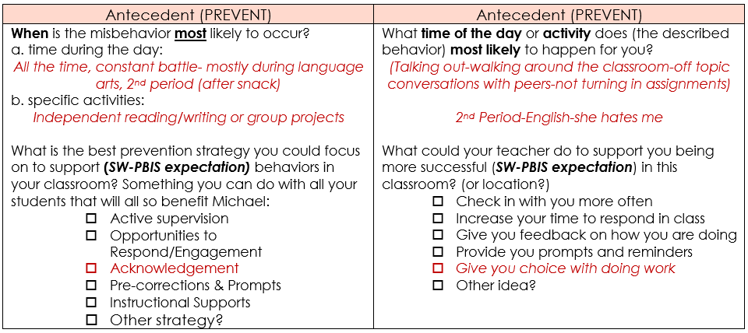
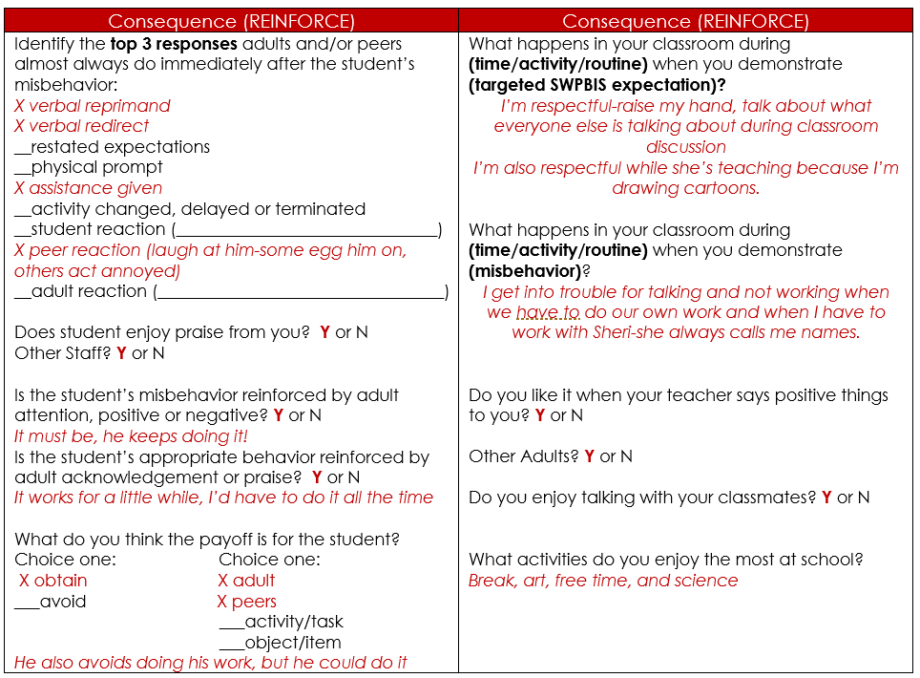
TFI T3 Features:
TFI 3.9 Academic, Social, and Physical Indicators: Assessment data are available for academic, behavioral, medical, and mental health strengths and needs, across life domains where relevant.

Slide 20
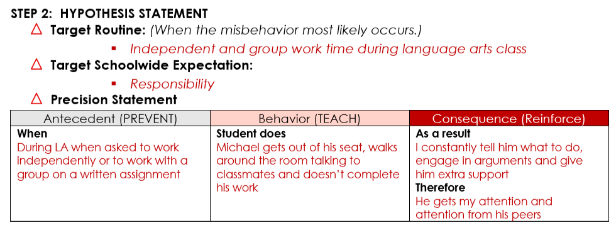
TFI T3 Features:
TFI 3.10 Hypothesis Statement: Behavior support plans include a hypothesis statement, including (a) operational description of problem behavior, (b) identification of context where problem behavior is most likely, and (c) maintaining reinforcers (e.g., behavioral function) in this context.

Slide 21
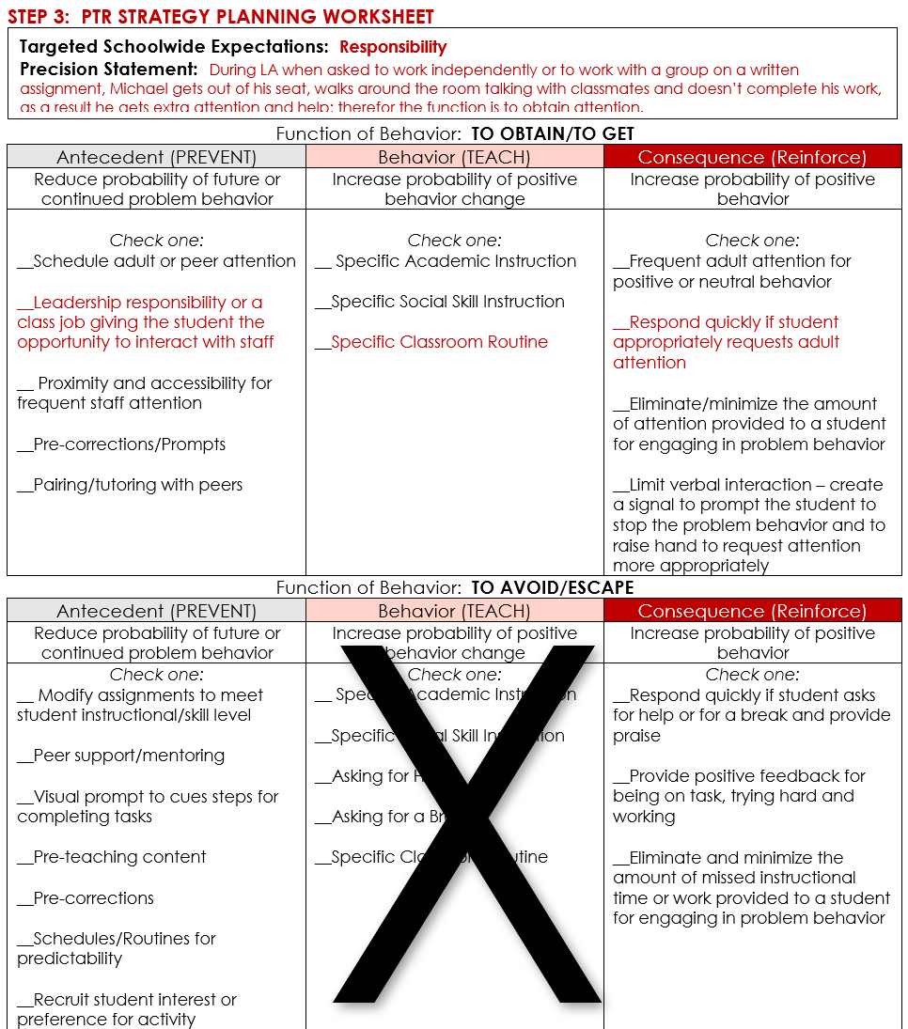
TFI T3 Features:
TFI 3.11 Comprehensive Support: Behavior support plans include or consider (a) prevention strategies, (b) teaching strategies, (c) strategies for removing rewards for problem behavior, (d) specific rewards for desired behavior, (e) safety elements where needed, (f) a systematic process for assessing fidelity and impact, and (g) the action plan for putting the support plan in place.
TFI 3.13 Access to Tier 1 and Tier 2 Support: Students receiving Tier 3 supports have access to,and are included in available Tier 1 and Tier 2 supports.

Slide 22
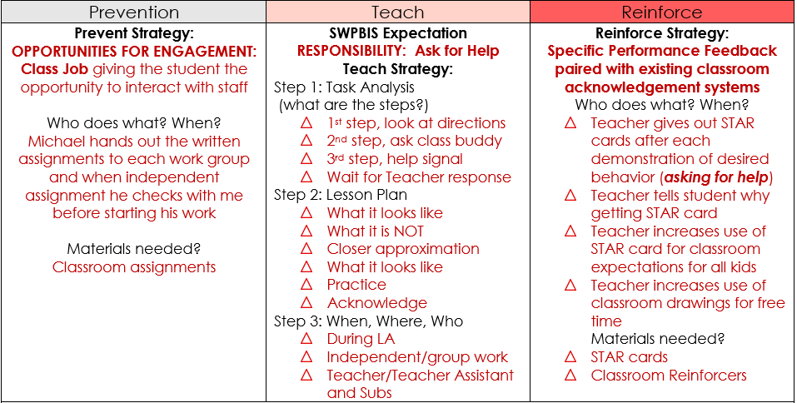

Slide 23
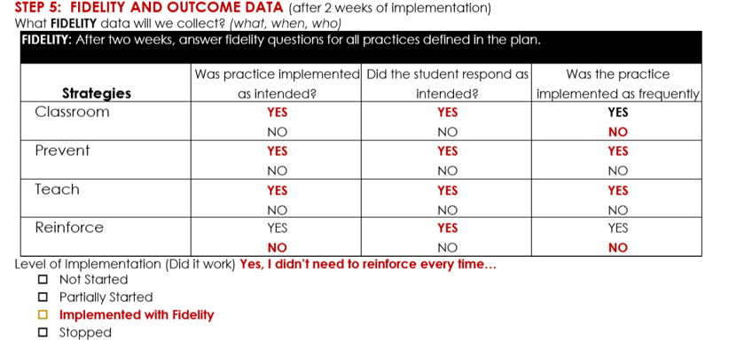
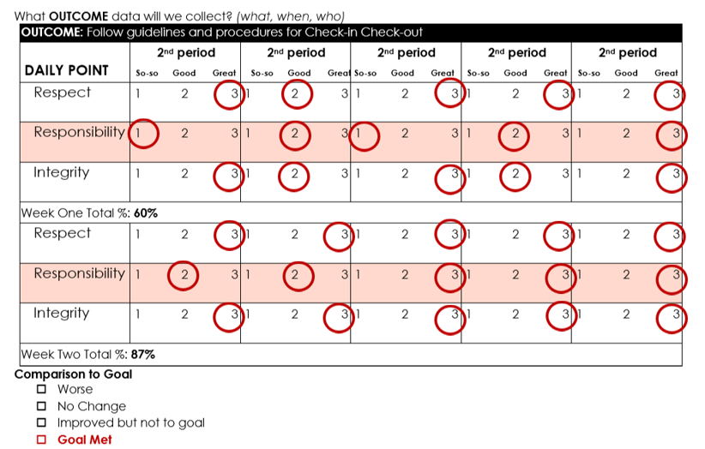

Slide 24
Item 3.15: Data-based Decision Making
Outcome
Fidelity
DATA
We made impact!
We got results!
We worked the plan the way it was designed.
We gave it our best effort!
Notes:
Remember that we always want to look at the fidelity of our systems and practices as well as the impact on student behavior or performance.

Slide 25
Tier 3 Comprehensive
Team-based
PTR 2nd Edition
Step 1: Teaming and Goal Setting
Step 2: Data Collection
Step 3: Functional Behavioral Assessment
Step 4: Intervention
Step 5: Progress Monitoring
& Data Based Decision Making

Slide 26
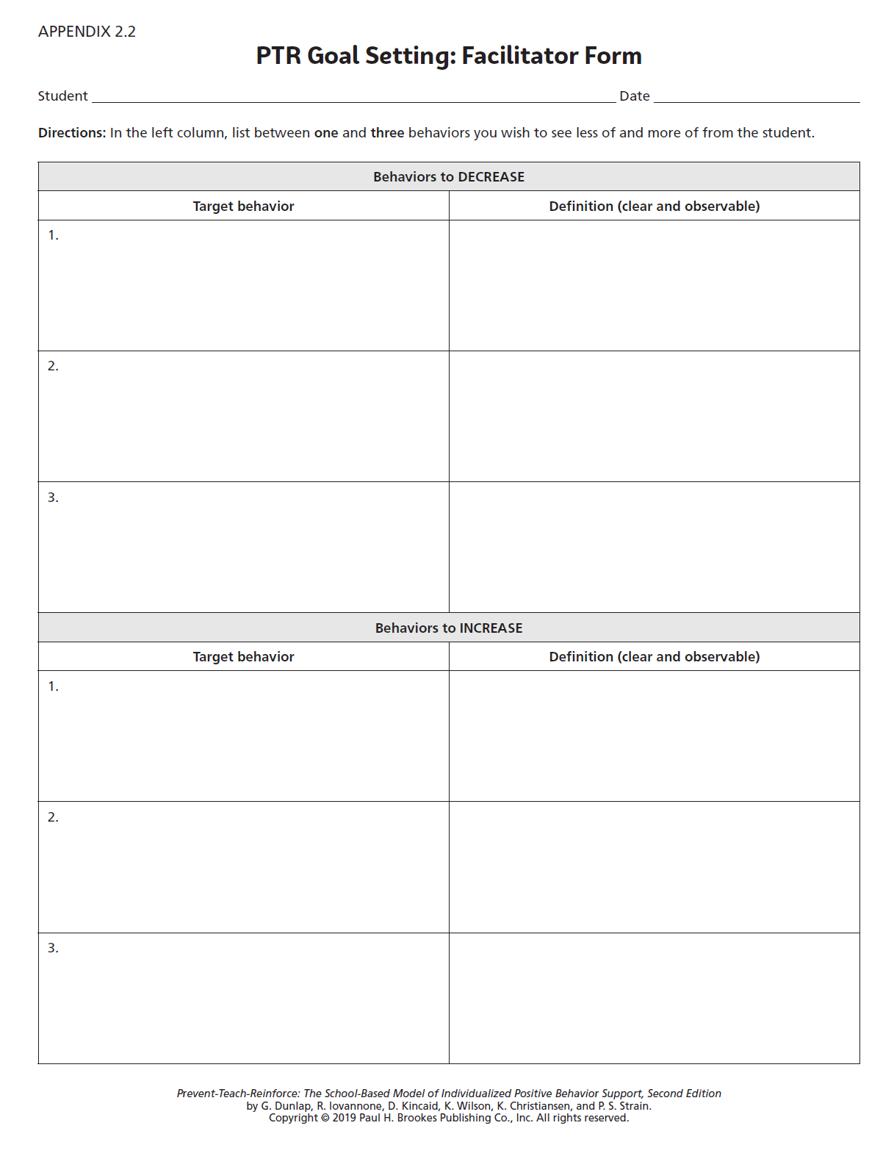
Step 1:
Teaming &
Goal Setting
Item 3.4: Student Support Team
Item 3.8: Quality of Life Indicators

Slide 27
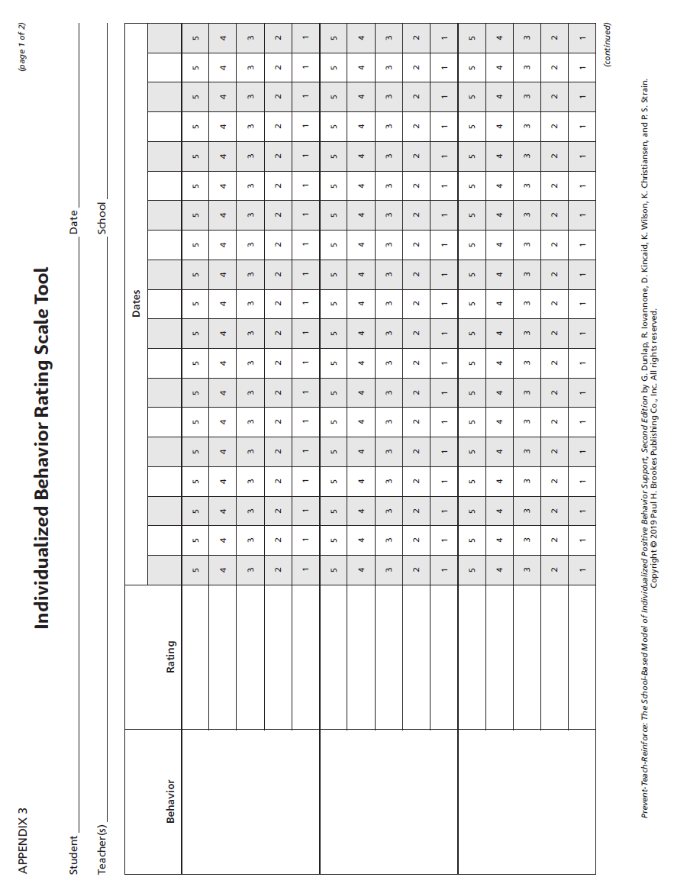
Step 2:
Data
Collection
Item 3.15: Data-based Decision Making

Slide 28
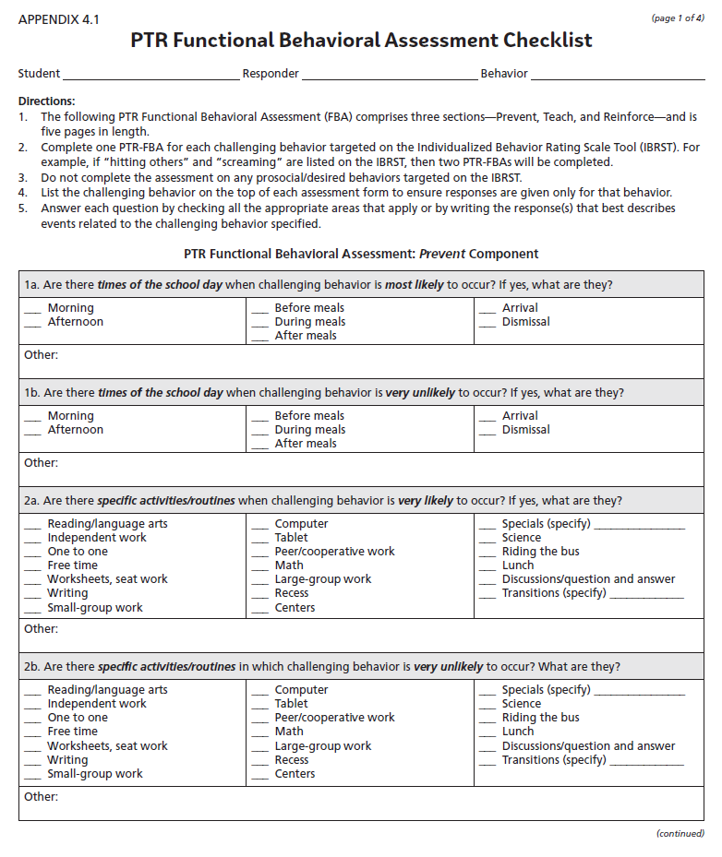
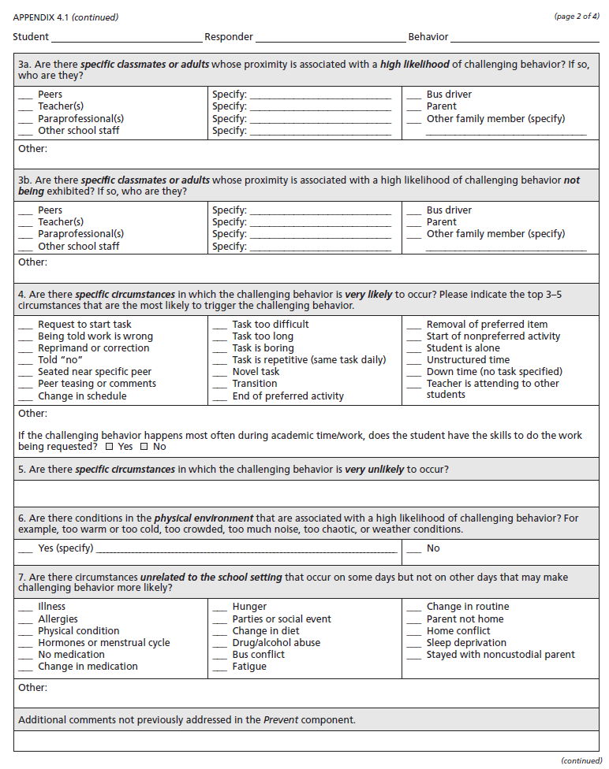
Step 3:
Function-
based
Assessment
Item 3.9: Academic, Social, and Physical Indicators

Slide 29
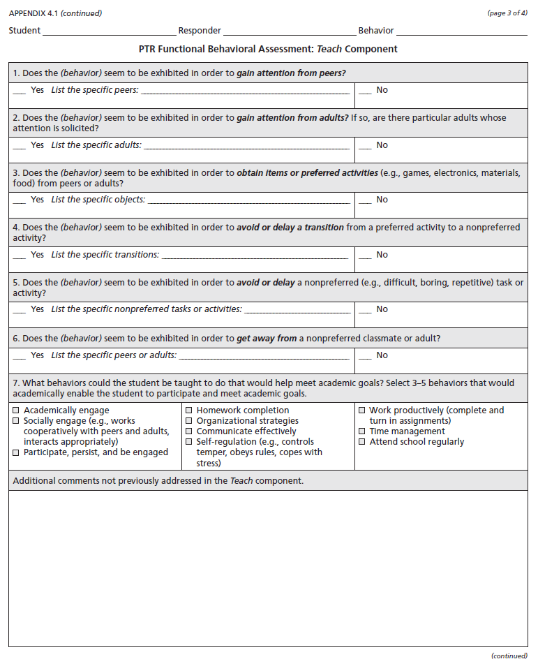
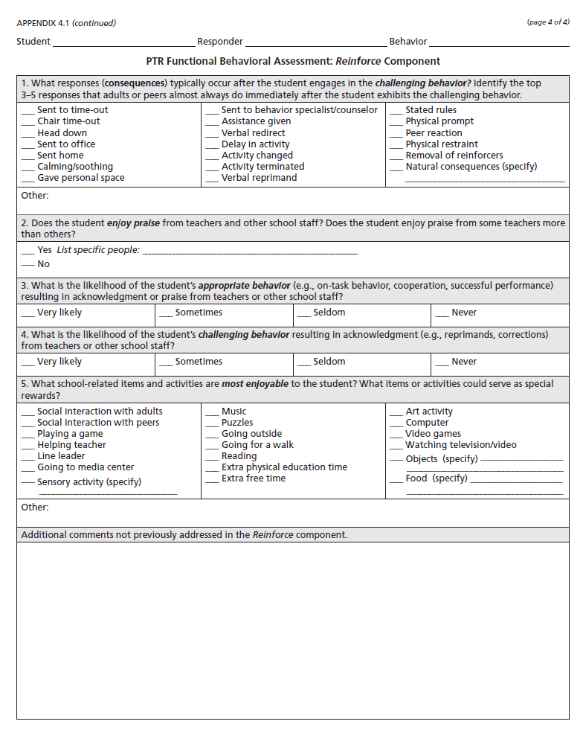
Item 3.9: Academic, Social, and Physical Indicators

Slide 30
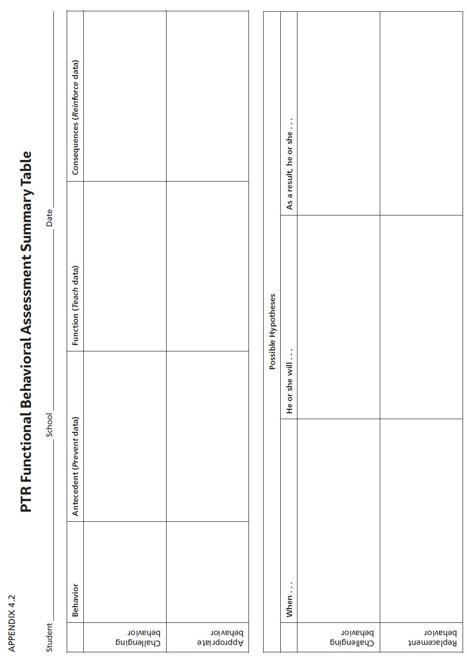
Item 3.10: Hypothesis Statement

Slide 31
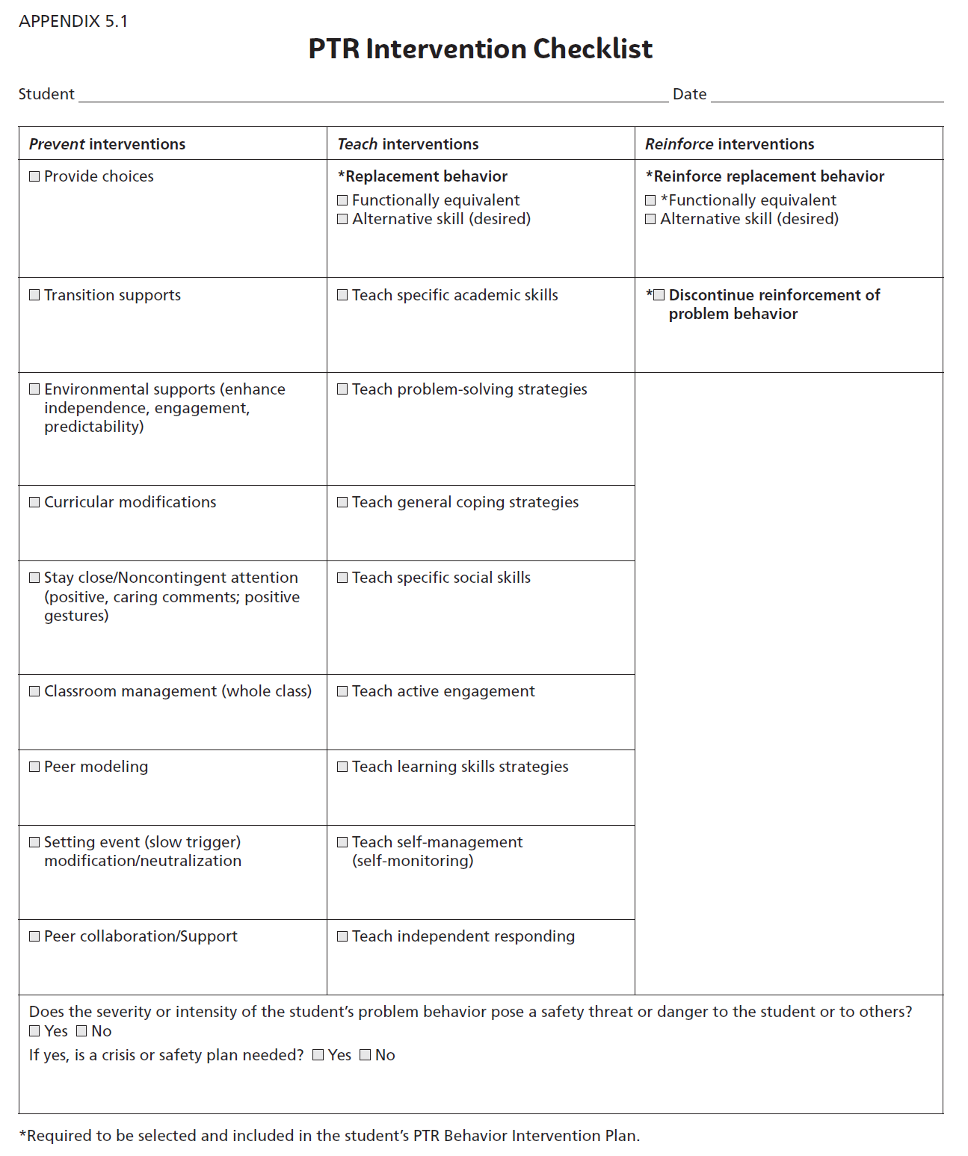
Step 4:
Behavior
Intervention
Plan
Item 3.11: Comprehensive Support

Slide 32
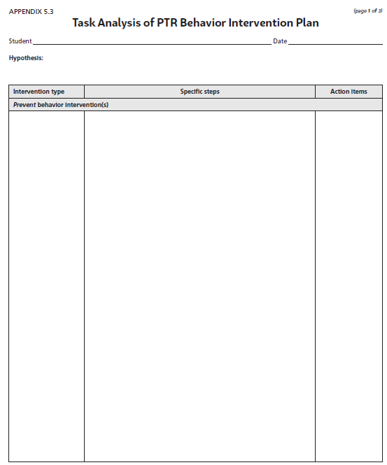
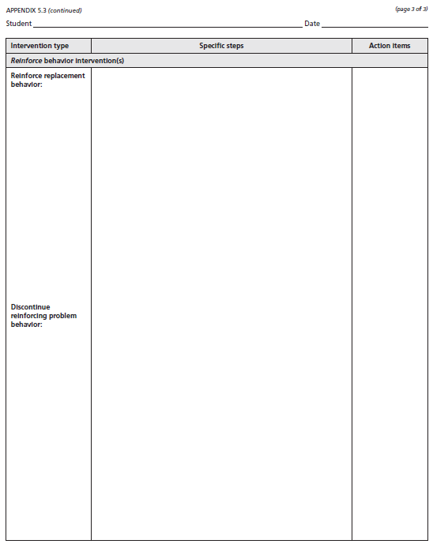
Task Analysis *This important feature contributes heavily toward implementation fidelity.
Prevent Interventions | Teach Interventions | Reinforce Interventions
Item 3.13: Access to Tier 1 & II Supports

Slide 33
Training, Coaching and Ongoing Support
Review the Plan and Develop a PTR Plan Assessment for Coaching/Fidelity
Train the Teacher to Implement the Plan
Train Others to Implement the Plan
Determine How Best to Provide Active Coaching Support
Begin Plan Implementation with Active Coaching Support
Notes:
Cristy

Slide 34
A + B = C Adult Behaviors equal student Change
Outcome
Fidelity
DATA
We made impact!
We got results!
We worked the plan the way it was designed.
We gave it our best effort!
Notes:
Remember that we always want to look at the fidelity of our systems and practices as well as the impact on student behavior or performance.

Slide 36
Barbara Kelley
barbara@pbiscaltac.org
Cristy Clouse
cristy@pbiscaltac.org
www.pbiscaltac.org

